Slide 1
帳單Draft API(docx)

Slide 2
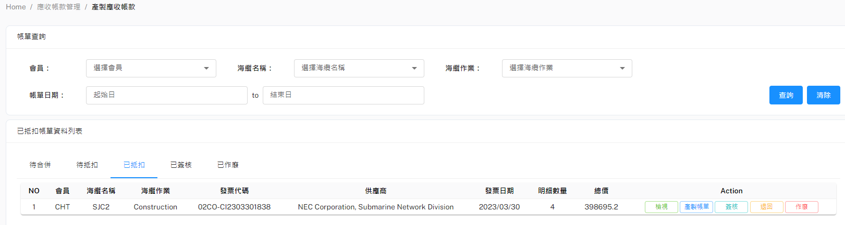
POST(帳單Draft)-產製帳單按鈕
POST Body
URL: http://localhost:8000/api/v1/getBillMasterDraftStream
{
"BillMasterID": 1,
"UserID": "chang_ty",
"GetTemplate": true
}

Slide 3
Response example
{
"ContactWindowAndSupervisorInformation": {
"Company": "International Business Group,\r\nChunghwa Telecom Co., Ltd.",
"Address": "No. 31 Aikuo E. Rd., Taipei, Taiwan, 106",
"Tel": "02-23443897",
"Fax": "02-23443897",
"DirectorName": "Hsuan-Lung Liu",
"DTel": "+886-2-2344-3912",
"DFax": "+886-2-2322-5940",
"DEmail": "lsl008@cht.com.tw"
},
"PartyInformation": {
"Company": "Chunghwa Telecom Co., Ltd. Network Technology Group",
"Address": "31, Aikuo East Road, Taipei, Taiwan 106",
"Contact": "黃宏杰",
"Email": "hj-hwang@cht.com.tw",
"Tel": "03-9772252"
},
"CorporateInformation": {
"BankName": "Bank of Taiwan, Hsinyi Branch",
"Branch": "",
"BranchAddress": "31 Aikuo E. Rd., Taipei, Taiwan, 106",
"BankAcctName": "SJC2 Central Billing Party of Chunghwa Telecom (International Business Group)",
"BankAcctNo": "054007501968",
"SavingAcctNo": "",
"IBAN": "",
"SWIFTCode": "BKTWTWTP054",
"ACHNo": "",
"WireRouting": "",
"Address": "88, Sec. 2, Sinyi Road, Taipei"
},
"DetailInformation": [
{
"Supplier": "NEC Corporation, Submarine Network Division",
"InvNumber": "DT0170168-1",
"Description": "BM9a Sea cable manufactured (except 8.5km spare cable))- Equipment",
"BilledAmount": 1288822.32,
"Liability": 7.1428571429,
"ShareAmount": 92058.74
},
{
"Supplier": "NEC Corporation, Submarine Network Division",
"InvNumber": "DT0170168-1",
"Description": "BM9a Sea cable manufactured (except 8.5km spare cable))- Service",
"BilledAmount": 1178227.94,
"Liability": 7.1428571429,
"ShareAmount": 84159.14
},
{
"Supplier": "NEC Corporation, Submarine Network Division",
"InvNumber": "DT0170168-1",
"Description": "BM12 Branching Units (100%)-Equipment",
"BilledAmount": 1627300.92,
"Liability": 7.1428571429,
"ShareAmount": 116235.78
},
{
"Supplier": "NEC Corporation, Submarine Network Division",
"InvNumber": "DT0170168-1",
"Description": "BM12 Branching Units (100%)-Service",
"BilledAmount": 1487661.54,
"Liability": 7.1428571429,
"ShareAmount": 106261.54
},
{
"Supplier": "NEC Corporation, Submarine Network Division",
"InvNumber": "test",
"Description": "BM9a Sea cable manufactured (except 8.5km spare cable))- Equipment",
"BilledAmount": -10,
"Liability": 100,
"ShareAmount": -10
},
{
"Supplier": "NEC Corporation, Submarine Network Division",
"InvNumber": "test",
"Description": "BM9a Sea cable manufactured (except 8.5km spare cable))- Service",
"BilledAmount": -10,
"Liability": 100,
"ShareAmount": -10
}
],
"InvoiceNo": "02CO-CI2303301838"
}

Slide 4


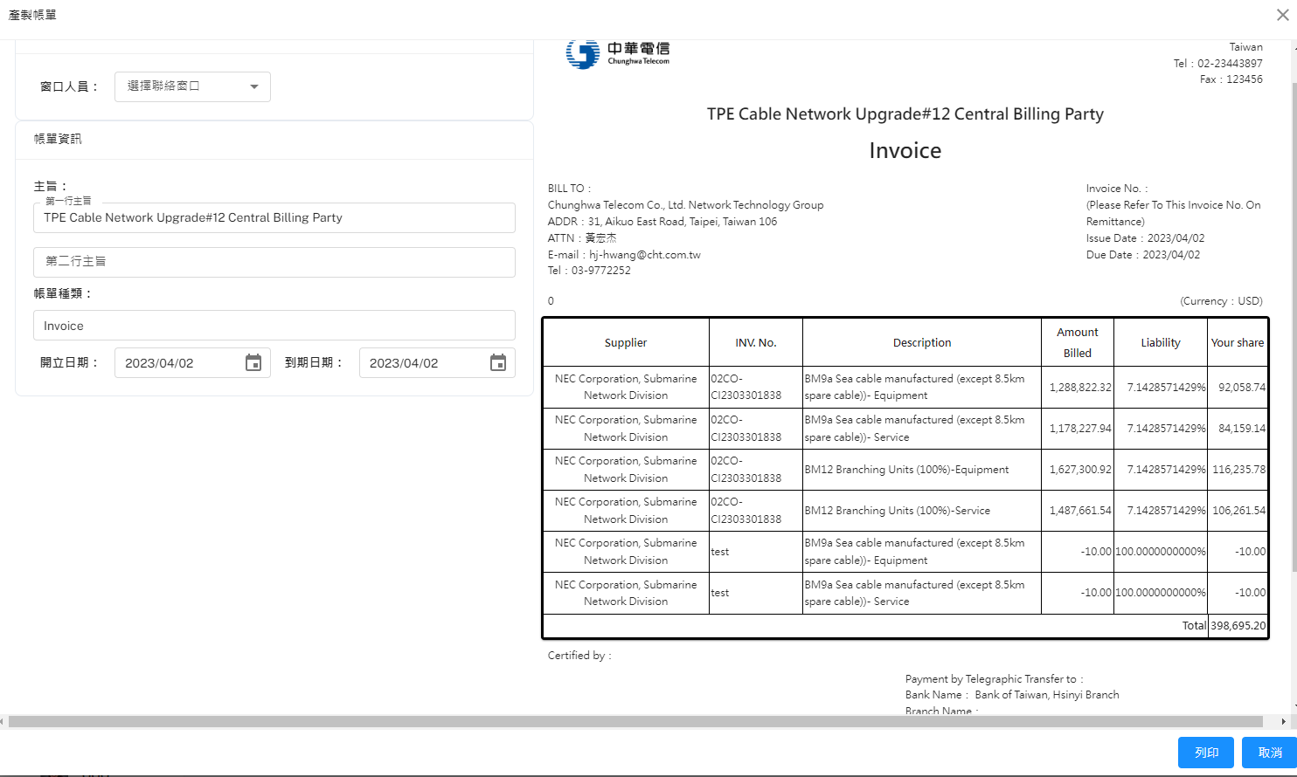
POST(帳單Draft)
POST Body
URL: http://localhost:8000/api/v1/getBillMasterDraftStream
{
"BillMasterID": 1,
"UserID": "chang_ty",
"IssueDate": "2023/04/01",
"DueDate": "2023/04/30",
"WorkTitle": "Construction #11",
"InvoiceName": "",
"logo": 1 or 2
"GetTemplate": false
}

